Slide 1

Chapter 2：Overview of Power Semiconductor Switches
2-1 Introduction
2-2 Diodes
2-3 Thyristors
2-4 Desired Characteristics in Controlled
Switches
2-6 Metal-Oxide-Semiconductor Field Effect
Transistors
2-8 Insulated Gate Bipolar Transistors
2-10 Comparison of Controllable Switches

Slide 2
本章知识点：
1、掌握MOSFET、IGBT、Thyristor和Diode等常用电力电子开关器件的电气符号和电气特性；
2、了解MOSFET、IGBT、Thyristor和Diode等器件的基本工作原理和开关损耗；
3、了解新型电力电子开关器件的发展。

Slide 3
2-1 Introduction
1 The concept of power electronic devices
Power electronic devices（电力电子器件）: are the electronic devices that can be directly used in the power processing circuits to convert or control electric power.
Very often: Power electronic devices = Power semiconductor devices
Major material used in power semiconductor devices——Silicon

Slide 4
2 Features of power electronic devices（电力电子器件的主要特征） ☆
⑴ The electric power that power electronic device deals with is usually much larger than that the information electronic device does.

Slide 5
⑵ Usually working in switching states（on-off 开关状态） to reduce power losses.
Voltage across the device is 0
v=0
p=vi=0
On-state
+
v
-
i
Current through the device is 0
i=0
p=vi=0
Off-state
+
v
-
i

Slide 6
⑶ Need to be controlled by information electronic circuits. Very often, drive circuits are necessary to interface between information circuits and power circuits.
Electric isolation:
optical or magnetic
Control circuit (in a broad sense)
Detection
(measurement)
circuit
Power circuit
(power stage,
main circuit)
Control circuit
drive
circuit

Slide 7
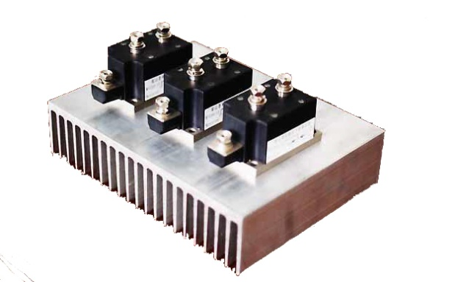
⑷ Dissipated power loss usually larger than information electronic devices — special packaging and heat sink(散热器) are necessary.

Slide 8
3 Power losses on power semiconductor devices ☆
v
t
i
t
p
t
On-state
Off-state
Turning on
turningoff
Conduction loss
Switching loss (turn-off loss + turn-on loss)
Off-state loss (usually very small and can be neglected)

Slide 9
Topic 2-1☆ ：What the influence of following parameters on power device losses?
on-state current（通态电流）
on-state resistor/on-state voltage（通态电阻/通态压降）
turn-on/turn-off time（开通/关断时间）
operating frequency（工作频率）

Slide 10
4 A classification of power electronic devices ☆
Uncontrolled device (Uncontrollable device)（不可控器件）
Half-controlled device (Half-controllable device)（半控器件）
Fully-controlled device (Fully-controllable device)（全控器件）

Slide 11

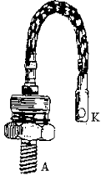




⑴ Uncontrolled device —— Diode
Appearance（封装）
Structure（结构）
Symbol（符号）
A
K
Anode
Cathode
Anode
Cathode

Slide 12
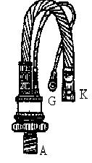
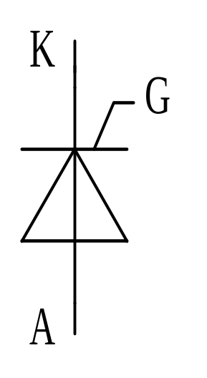

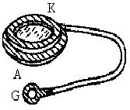

⑵ Half-controlled device ——thyristor (晶闸管)or Silicon controlled Rectifier (可控硅)
turned-on by a control signal and turned-off by the power circuit
Cathode
Gate
Anode

Slide 13
⑶ Fully-controlled device——Power MOSFET, IGBT, BJT, GTO, IGCT
The on and off states of the device are controlled by control signals.
MOSFET: Metal-Oxide-Semiconductor Field-
Effect Transistors
IGBT: insulated-Gate Bipolar Transistors
GTO: Gate-Turn-off Thyristors
IGCT: Integrated-Gate-Controlled Thyristors

Slide 14
Other new power electronic devices:
Static induction transistor —SIT
Static induction thyristor —SITH
MOS controlled thyristor — MCT

Slide 15
Other classifications
Current-driven (current-controlled) devices
Voltage-driven (voltage-controlled) devices (Field-controlled devices)
Pulse-triggered devices
Level-sensitive (level-triggered) devices
Unipolar devices (单极型器件) (Majority carrier devices)
Bipolar devices (双极型器件) (Minority carrier devices)
Composite devices (复合型器件)

Slide 16
双极型器件特点
  通态压降较低、阻断电压高、电流容量大
单极型器件特点
  开关时间短、输入阻抗高（电压控制型）
  具有负的电流—温度特性，即正的电阻—温度特性。
  通态压降高、电压和电流定额较小。
复合型器件特点
  既有电流容量大、导通压降小的优点；
  又有输入阻抗高、响应速度快的优点。

Slide 17
5 Passive components（无源器件） in power electronic circuit
Transformer, inductor, capacitor and resistor
These are called passive components in a power electronic circuit since they can not be controlled by control signal and their characteristics are usually constant and linear.
The requirements for these passive components by power electronic circuits could be very different from those by ordinary circuits.

Slide 18
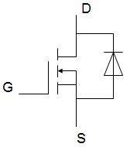




Power Devices and Components
(1) Power Devices－Power Semiconductor Switch
(2) Magnetic Components－Inductors (Transformers)
(3) Capacitive Components－Capacitors
A
C
A
G
……
K
E
G
K
Power Electronics
Zhang Liwei(张立伟)

Slide 19
Capacitor
Idealized characteristics:
Pure capacitance
Voltage cross terminals is not changed abruptly
i-v equation i=Cdu/dt
Power Electronics
Zhang Liwei(张立伟)

Slide 20


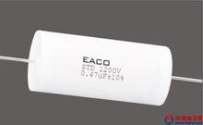


Capacitor
Real characteristics:
Co
ESR Ro
ESL Lo
(1)
Co
ESL Lo
(2)
EPR Ro
Power Electronics
Zhang Liwei(张立伟)

Slide 21
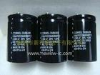
Capacitor
Notes for applications:
Capacitance
Equivalent resistance, especially for capacitors in series application
Lifetime comparison of 85 and 105 degree in Centigrade (Celsius) Aluminum Capacitors, ten degree increased with lifetime decreased by half
Inductance free capacitor for high-frequency application
Power Electronics
Zhang Liwei(张立伟)

Slide 22
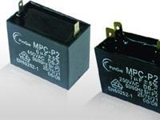

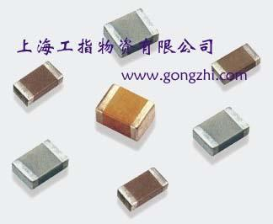
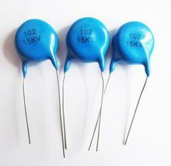
Capacitor
Basic types of capacitor for PE converters:
1. Aluminum Capacitor
2. Metalized Polypropylene Capacitor(聚丙烯薄膜电容器)
3. Ceramic Capacitor(陶瓷电容器)
Having a significant equivalent Series Resistance (ESR). For low-frequency ripple currents, ESL can be neglected, the ripple is mainly determined by Ro and Co.
  Having a very small loss coefficient of the polypropylene dielectric material. In snubbers and Thyristor commutation circuits, the MPC is usually served to applications.
Having extremely low series inductance. They are used as filters, decoupled capacitor on PCB etc.
Power Electronics
Zhang Liwei(张立伟)

Slide 23

inductor / Transformer
Idealized characteristics:
Pure inductance
Current through it is not changed abruptly
Exciting Current is zero in transformer
i-v equation: u=Ldi/dt
H-B curve(磁化曲线): linearized proportional relationship
Power Electronics
Zhang Liwei(张立伟)

Slide 24

Inductor / Transformer
Real characteristics:
ESC Co
ESR Ro
Lo
(1)
ESR Ro
Lo
(2)
EPC Co
Power Electronics
Zhang Liwei(张立伟)

Slide 25
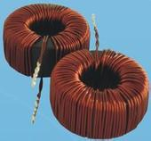
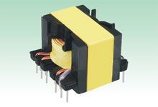
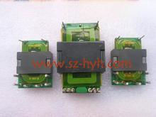
Inductor / Transformer
Notes for applications
Inductance
Equivalent Resistance
Avoid operating saturated state
Copper loss and Core loss
Power Electronics
Zhang Liwei(张立伟)

Slide 26

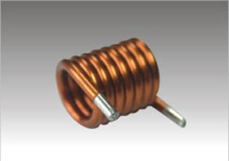
Inductor / Transformer
Basic types of inductor for PE converters:
1. Ferromagnetic core inductor(铁磁芯)
2. Air core inductor
Having a significant inductance, but with core loss and characteristics ferromagnetic core (hysteresis loop and saturation issues)
  Having a small value of inductance, but without ferromagnetic issues. Application areas: high frequency and low inductance value, such as soft-switching techniques.
Power Electronics
Zhang Liwei(张立伟)

Slide 27
Inductor / Transformer
Relationship between inductor and transformer
Power Electronics
Zhang Liwei(张立伟)

Slide 28
2-2 POWER DIODES（电力二极管）
Appearance
Structure
Symbol
A
K
Anode
Cathode
Anode
Cathode

Slide 29
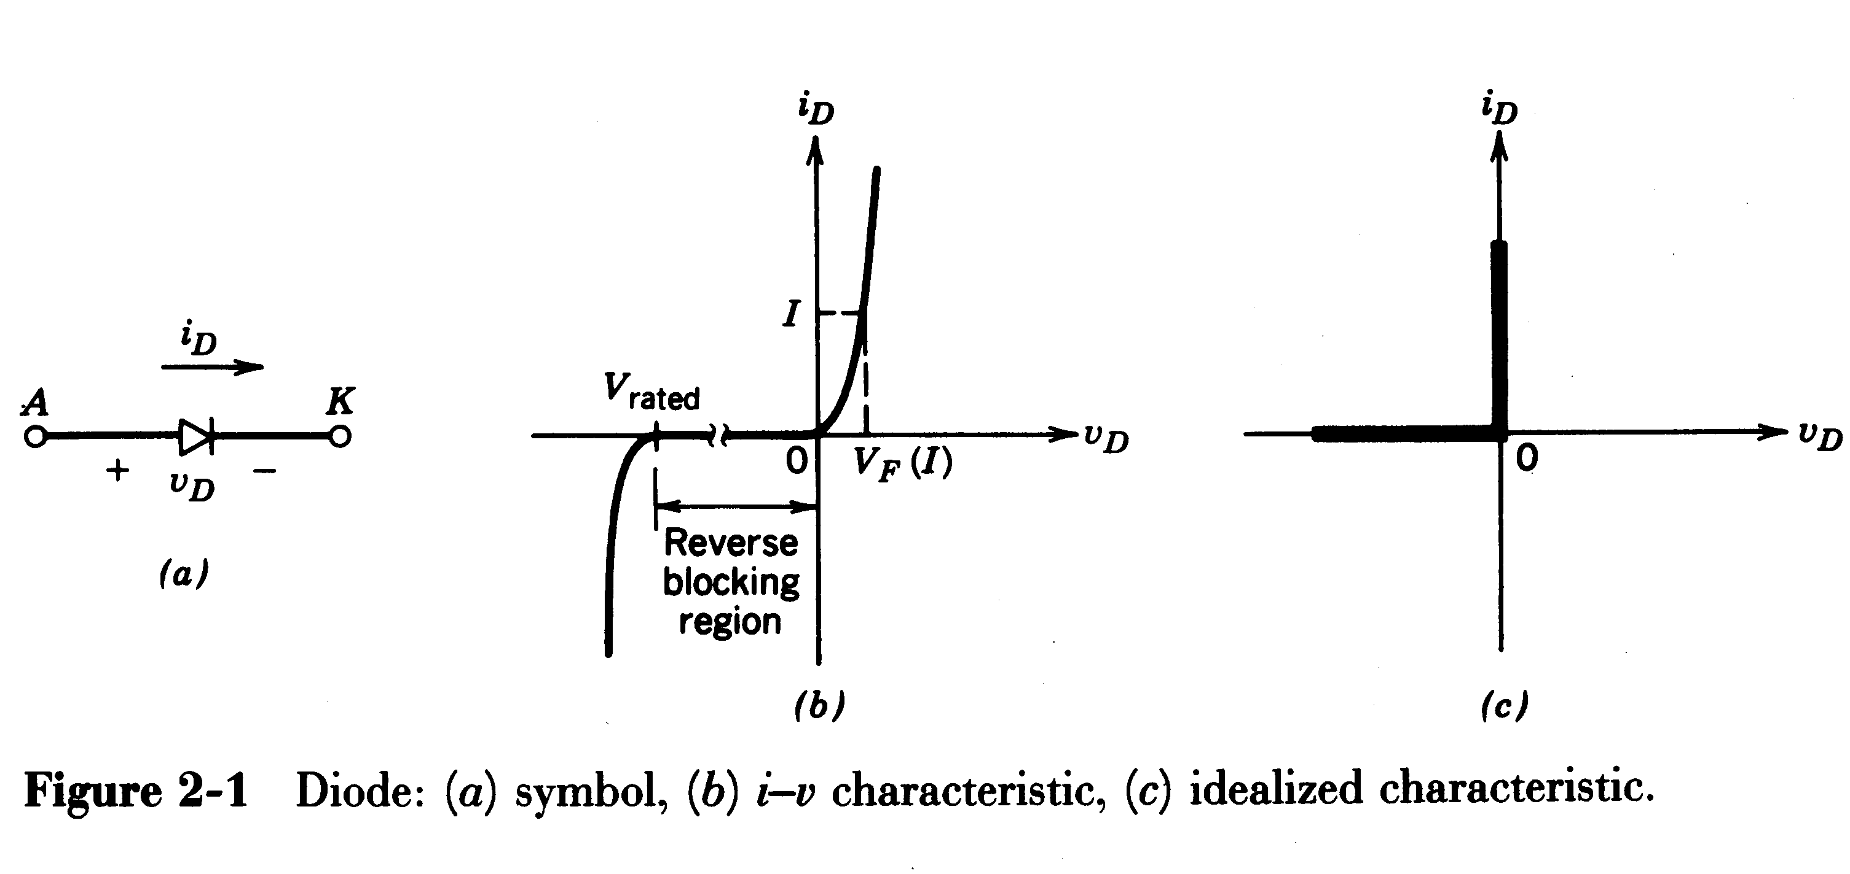
1 Static characteristics of power diode（静态特性）
The I-V characteristics of power diode

Slide 30
2 Types of power diodes ☆
Line-frequency diodes (工频二极管 rectifier diodes)
The on-state voltage is very low
Have larger reverse-recovery time t_{rr} (t_{rr}>5µs)
Have blocking voltage rating of several kilovolts and current ratings of several kiloamperes
Be acceptable for line-frequency applications
On-State Voltage: The voltage drop across a device during its on-state while conducting a current.
The smaller this voltage, the smaller will be the on-state power loss.

Slide 31
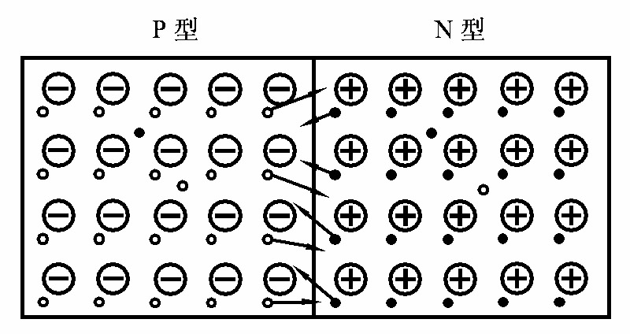
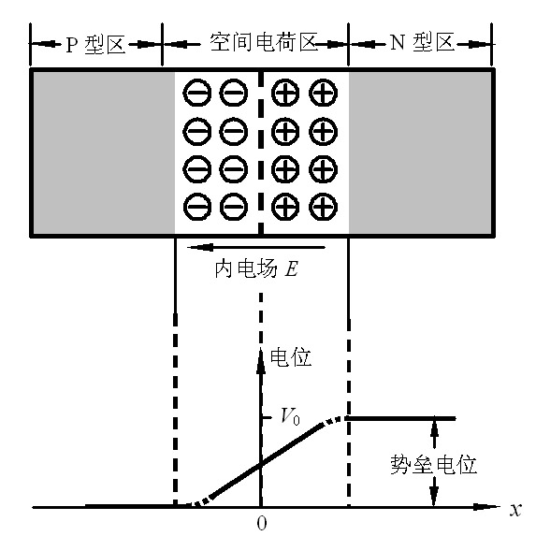
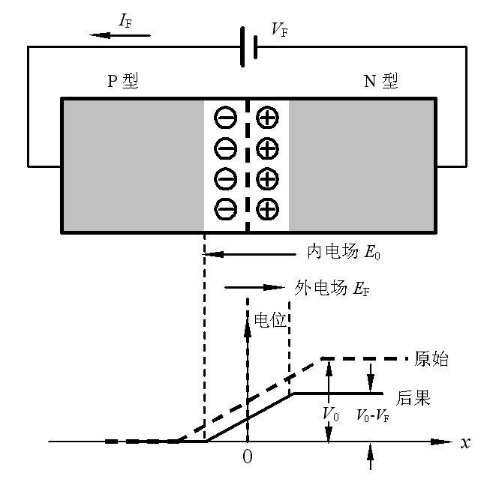

Slide 32
二极管正向导通过程又称为
正向恢复过程（Forward Recovery）
正向恢复峰值电压
V
FP
IF
正向恢复时间
VF
t
fr

Slide 33
电压过冲的两个物理机制：阻性机制和感性机制：
1、阻性机制
阻性机制是指少数载流子注入的电导调制作用。导通初期，
二极管的主要是低掺杂N区的欧姆电阻，其值高且为常量，因而管压降随着电流的上升而升高。
当电流上升到一定数值是，注入并积累在低掺杂N区的少数载流子空穴不断增加，使其电阻率明显下降，这就是电导调制作用。
电导调制使N区的有效电阻随着正向电流的上升而下降，管压降即随之降低，从而形成峰值VFP.

Slide 34
2、感性机制
感性机制是指正向电流随时间上升在器件的内部电感上产生压降，器件的内部电感由硅片电感和电级连接件电感两部分组成。电感压降只存在于电流上升过程，正向电流渐趋于稳定时即趋于零。
由于有电感压降的存在，因而峰值压降VFP必是电流上升率di/dt的函数， di/dt越大， VFP也就越高。
VFP中的阻性分量只在di/dt较小时才起主要作用。

Slide 35
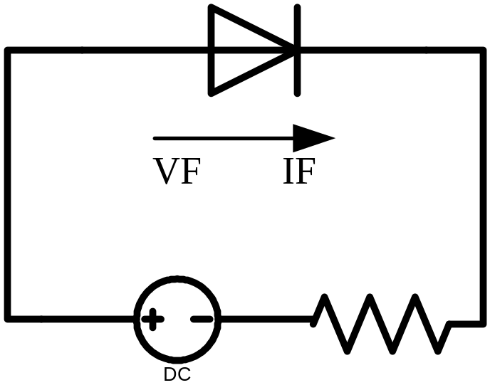
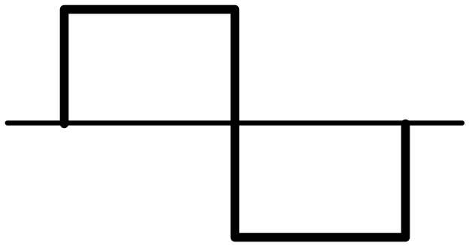
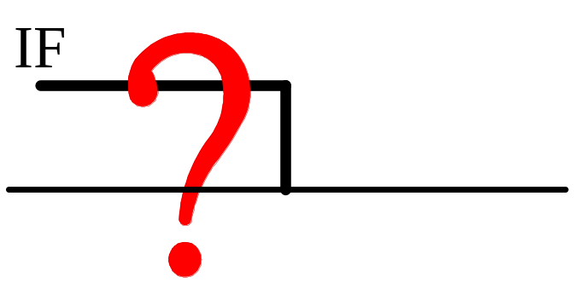
二极管关断过程中的动态性能
在由正向偏置转化为反向偏置的瞬间会发生什么？

Slide 36
两个因素影响二极管关断过程中的动态性能
1、线路分布电感－实际的电路中电流不可能出现突变。
2、PN结内部的恢复过程。
正向偏置（正向导通）期间，遗留了大量被注入的少子，正常的复合速度较慢。
这些少子的存在，使二极管在变成反偏置之后的一段时间内将维持导通，产生反向电流。
反向电流将加速少子的复合。当所有少子复合消失后，二极管恢复阻断。

Slide 37
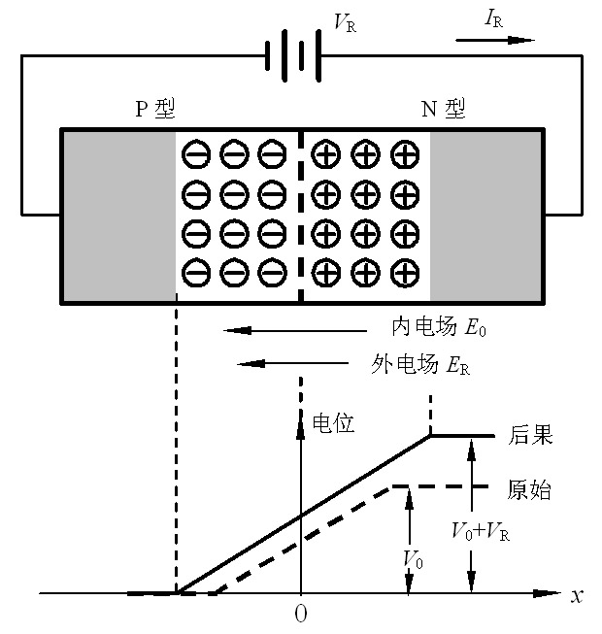
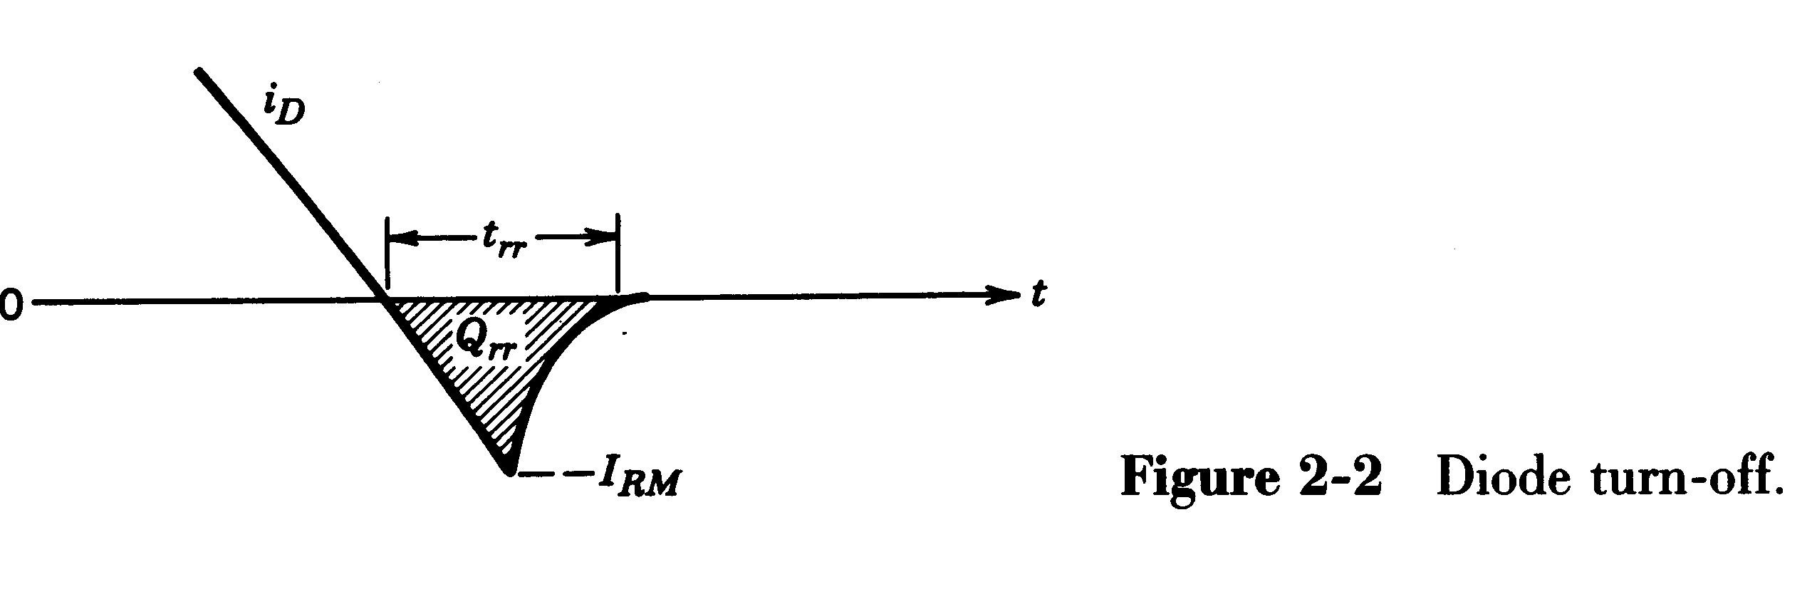
Reverse-recovery time（反向恢复时间） t_{rr}

Slide 38

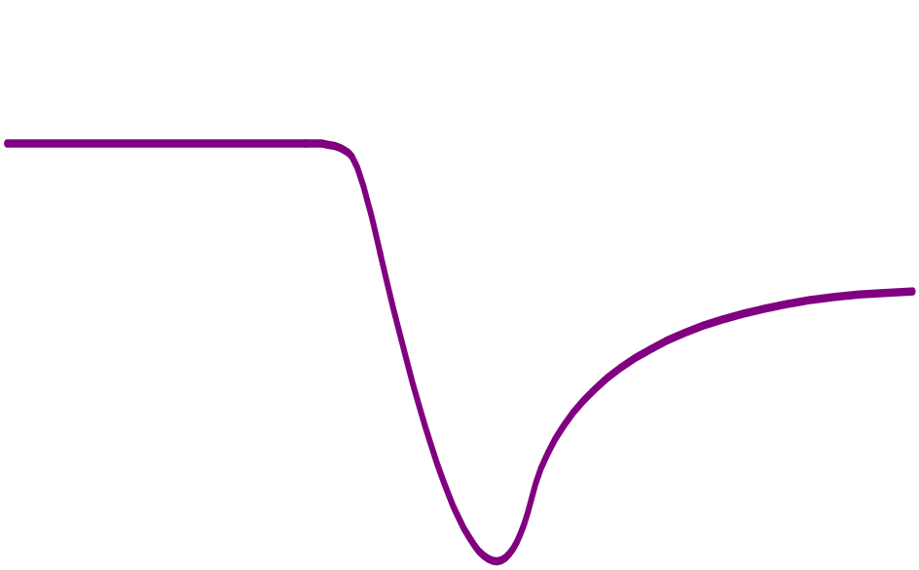

二极管反向恢复（Reverse Recovery）过程
正向导通
正向电流下降
反向电流增大
恢复反向阻断
电压反向
反向恢复峰值电流－I_{RP}
反向恢复峰值电压－V_{RP}
反向恢复时间－t_{rr}

Slide 39
二极管反向恢复过程总结
正向偏置二极管的正向电流带来大量“少子”。
二极管变成反向偏置后，在分布电感的制约下，电流“只能”逐渐下降。
当电流降为0后，受滞留的少子的影响，使得二极管维持导通，电流负向增长。
负向电流逐渐清除少子。
当少子基本清除干净后，PN结开始恢复阻断能力负向电流的大小开始减小。

Slide 40
Fast-recovery diodes（快恢复二极管）
Have a small reverse-recovery time (t_{rr} ratings of less than 1µs)
have blocking voltage rating of several hundred volts and current ratings of several hundred amperes
Be used in high-frequency circuits
Schottky diodes （肖特基二极管）
Have lowest t_{rr} ratings and low forward voltage drop (typically 0.3V)
have lowest blocking voltage rating (less than 200V)
Be used in high-frequency and low output voltage circuits

Slide 41
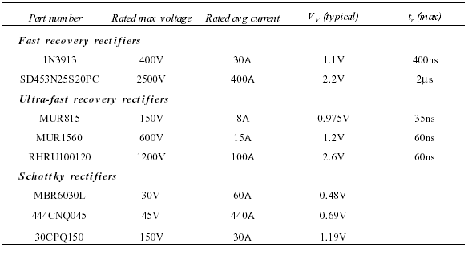
Examples of commercial power diodes

Slide 42
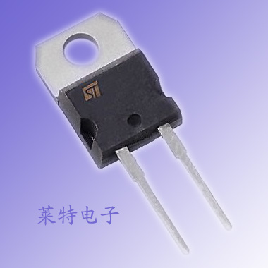
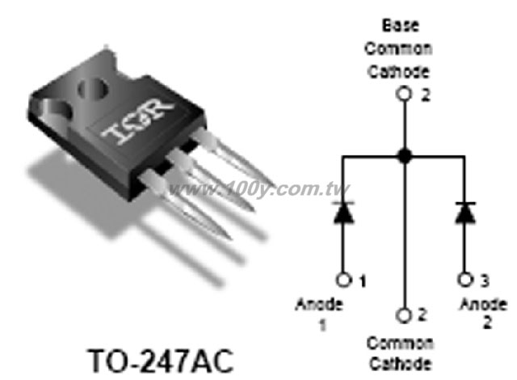

Slide 43
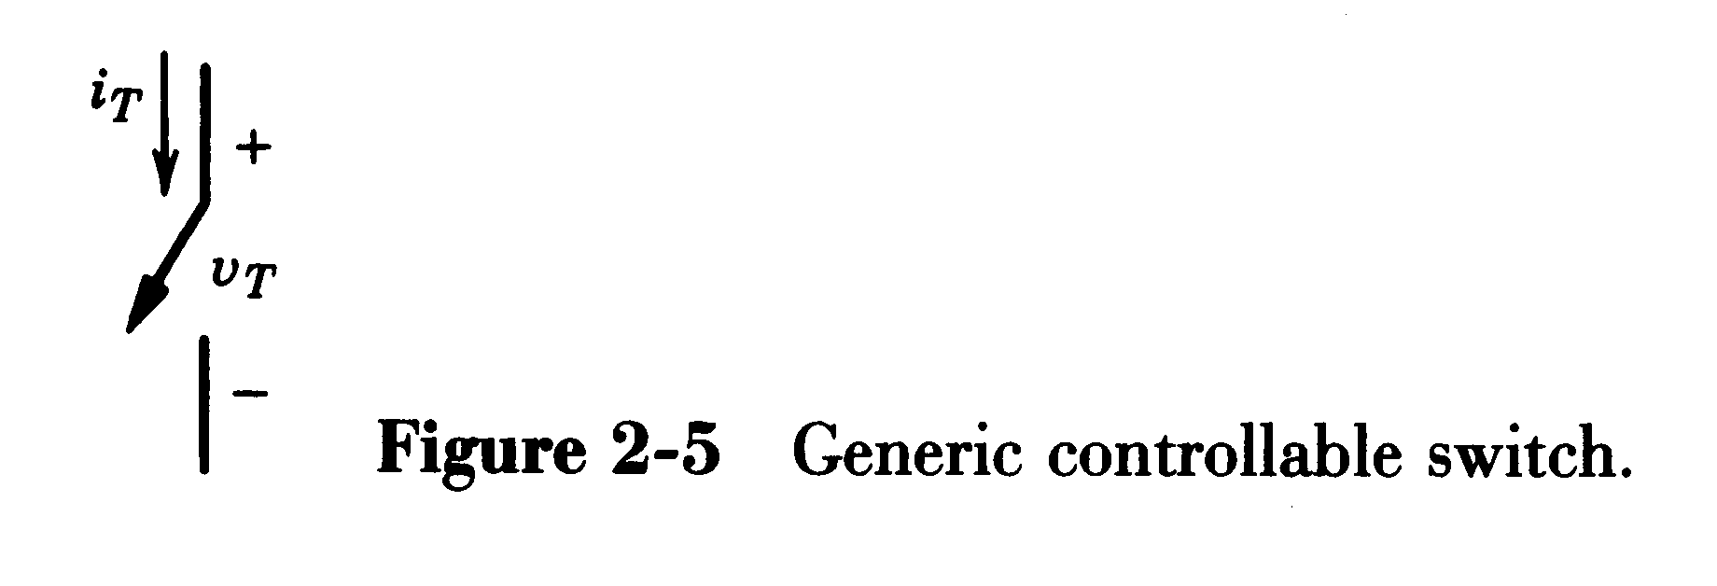
2-4 Desired Characteristics in Controlled Switches
1 The ideal characteristics
When on, current can flow only in the direction of the arrow
Instantaneous switching from one state to the other
Zero voltage drop in on-state
Infinite voltage and current handling capabilities

Slide 44
Real devices do not have these ideal characteristics and hence will dissipate power.
If they dissipate too much power, the devices can fail.
The converter designer must understand what factors governing power dissipation in the devices and how to minimize it.

Slide 45
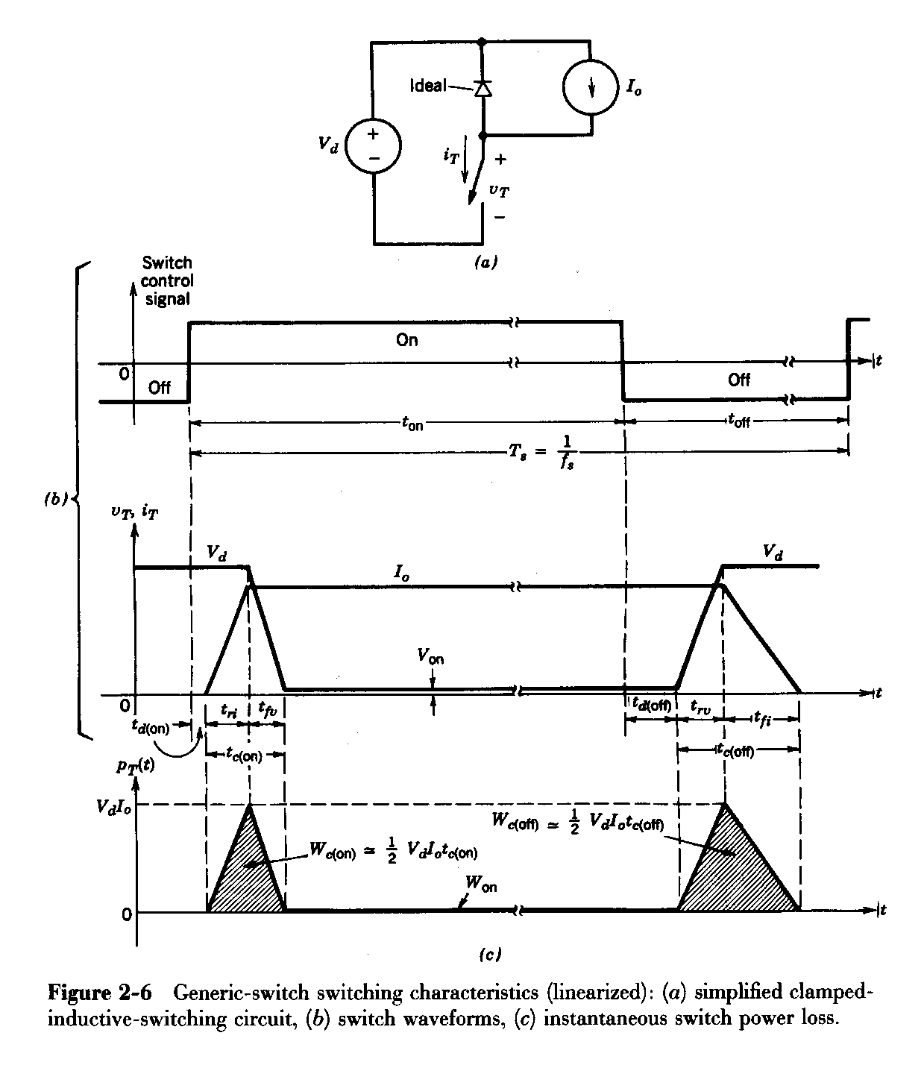
2 Practical Switching Characteristics (linearized)
Turn-on delay time—t_{d(on)}
Current rise time—t_{ri}
Voltage fall time—t_{fv}
Turn- interval--t_{c(on)}
T_{c(on)}=t_{ri}+t_{fv}
Turn-off delay time—t_{d(off)}
Voltage rise time—t_{rv}
Current fall time—t_{fi}
Turn-off interval—t_{c(off)}
T_{c(off)}=t_{rv}+t_{fi}

Slide 46
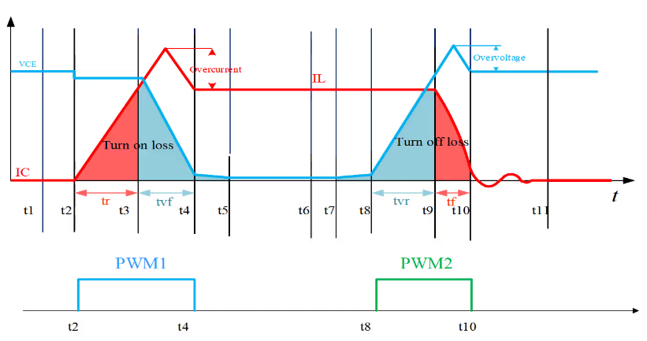

Slide 47
正向导通
正向电流下降
电压反向
Vd
正向导通
正向电流下降
反向电流增大
恢复反向阻断
电压反向
反向恢复峰值电流－I_{RP}
反向恢复峰值电压－V_{RP}
反向恢复时间－t_{rr}

Slide 48
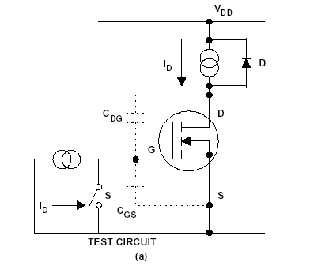
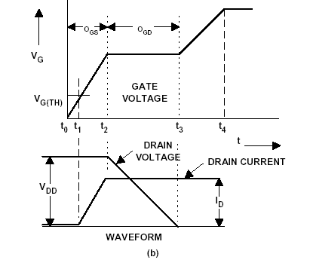
MOSFET开通过程
正向导通
正向电流下降
电压反向
Vd

Slide 49
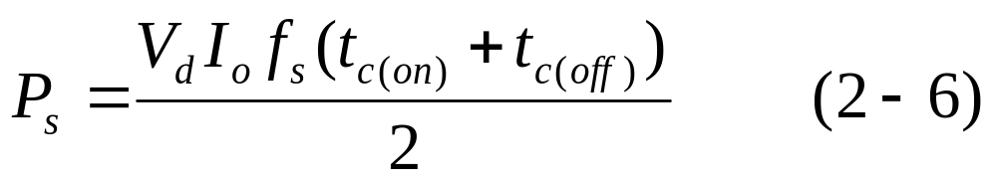
☆ Switching Power Loss (开关损耗） is proportional to:
switching frequency
turn-on and turn-off times
Devices with short switching times are possible to operate at high switching frequencies in order to reduce filtering requirements.

Slide 50
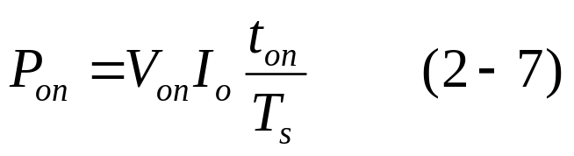
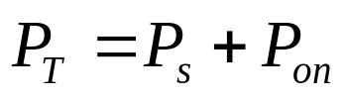
☆ On-state Power Loss （通态损耗） is proportional to:
on-state voltage
Due to small leakage current in the off state, the Off-state Power Loss（断态损耗） can be neglected in practice. Therefore, the total average power loss:

Slide 51
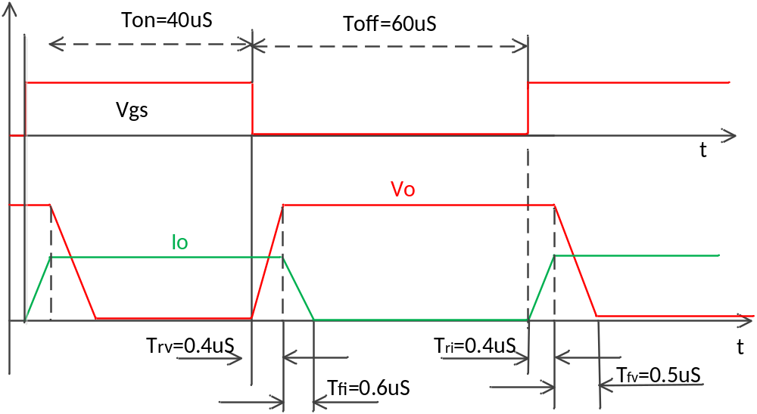
The control signal of switch is shown in Fig.1. If Vo=100V, Io=100A, voltage drop of switch Vsat=2V. The turn-on delay and turn-off delay time are neglected. Answer the following questions:
What is the switching frequency of the switch? (0.5 points)
What is the switching loss of the switch? (1 points)
What is the conduction loss of the switch? (0.5 points)
Fig.1

Slide 52
Solution:
Fs=1/(Ton+Toff)=1/(40uS+60uS)=10kHz
P_{switching_loss}=P_{turn_on}+P_{turn_off}=(0.4+0.5)*10⁻⁶*0.5*100*100*10*10³+(0.4+0.6)*10⁻⁶*0.5*100*100*10*10³=45+50=95W
P_{conduction_loss=}(T_{on}-T_{fv}-T_{ri})/(T_{on}+T_{off})V_{sat}*I_{O}=(40-0.5-0.4)/(40+60)*2*100=78.2W

Slide 53
3 Desired Characteristics in Controlled Switches ☆
(1) Small leakage current in the off state.
(2) Small on-state voltage V_{on} to minimize on-state losses.
(3) Short turn-on and turn-off times.
(4) Large forward- and reverse-voltage-blocking capability.
This will minimize the need for series connection of several device.
In most (but not all) converter circuits, a diode is placed across the controllable switch to allow the reverse-current flow. In those circuit, reverse-voltage-blocking capability are not required.

Slide 54
(5) High on-state current rating. This will minimize the need for parallel connection of several device.
(6) Positive temperature coefficient of on-state resistance. This ensures that paralleled devices will share the current equally.
(7) Small control power required to switch the device. This will simplify the drive circuit design.
(8) Capability to withstand rated voltage(额定电压) and rated current simultaneously while switching. This will eliminate the need for external protection (snubber) circuits.
(9) Large dv/dt and di/dt ratings. This will minimized the need for external protection (snubber) circuits.

Slide 55
2-6 MOSFET
1 Symbol
S D
G
D
D
N⁺
N⁺
G
G
P 型衬底
S
S
(掺杂浓度低)
N channel
P
channel
B
Three terminals:
D — 漏极 Drain，S — 源极 Source，G — 栅极 Gate

Slide 56
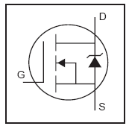
2 Operating principle
D
When applied positive V_{GS} (V_{GS} >> V_{GS(th)}), MOSFET turn-on;
When V_{GS}=0 or negative, MOSFET turn-off
G
S
N channel
Forward current flows from the drain to the source.
Note: Block only forward voltage, cannot block negative voltage because of its intrinsic anti-parallel diode.

Slide 57
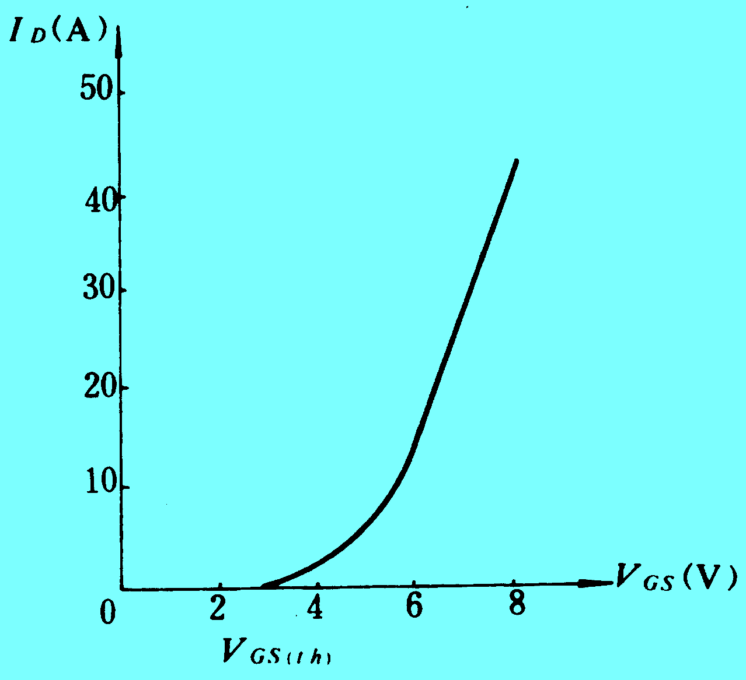
3 Characteristics（转移特性）
(1) i_{D}-V_{GS} characteristics
For gate voltages below a threshold value （开启电压）V_{GS(tH)} MOSFET is off. Beyond V_{GS(tH)} , the drain current i_{D} depends on the applied gate voltage V_{GS}. (V_{GS}↑→i_{D}↑and R_{on}↓)
Typically V_{GS}(th) is 2 to 4V, typically gate voltage V_{GS} is 10V.

Slide 58
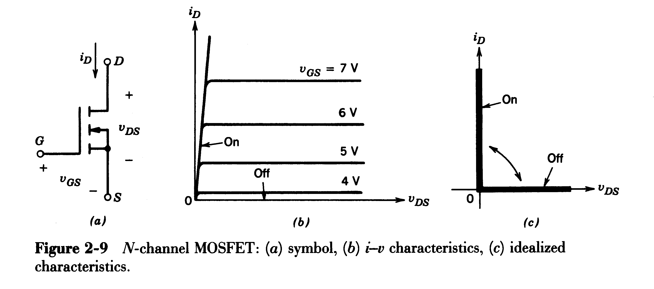
(2) i_{D}-v_{DS} characteristics （输出特性） Fig. 2-9(b):

Slide 59
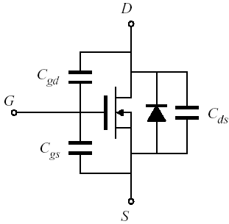
A simple MOSFET equivalent circuit
Input Capacitance C_{gs} : large, essentially constant
• Output Capacitance C_{gd} : small, highly nonlinear
• Reverse Transfer Capacitance （反向转移电容）C_{ds} : intermediate in value, highly nonlinear
• switching times determined by rate at which gate driver charges/discharges C_{gs} and C_{gd}

Slide 60
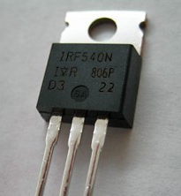
4 Features and applications of power MOSFET ☆
Unipolar device.
Voltage-driven device, easy to control by the gate , high impedance gate which requires a small current and charge to facilitate on/off transition.
Fast switching speed, used in high operating frequency (could be hundreds of kHz) applications.

Slide 61

On-state resistance increases rapidly with rated blocking voltage, used in low-voltage applications (Usually used at voltages less than 600V ).
On-state resistance has a positive temperature coefficient (On-state resistance goes up with the junction temperature within the device ) , therefore easily paralleled.
R_{DS(120 °C} ₎=2R_{DS(25} _{°C )}

Slide 62
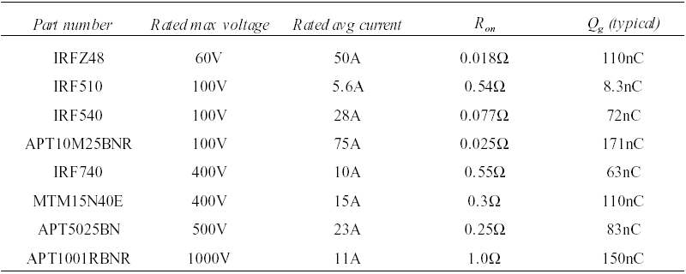
Examples of commercial power MOSFET

Slide 63
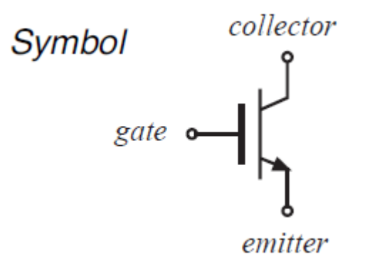
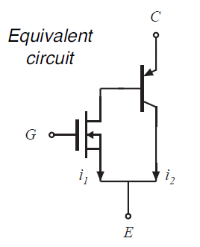
2-8 IGBT
1 Characteristics
Fig. 2-12(a):
unlike to the MOSFET, IGBT can block negative voltage, but most commercially available devices, cannot block negative voltage because of an extra anti-parallel diode with it.

Slide 64
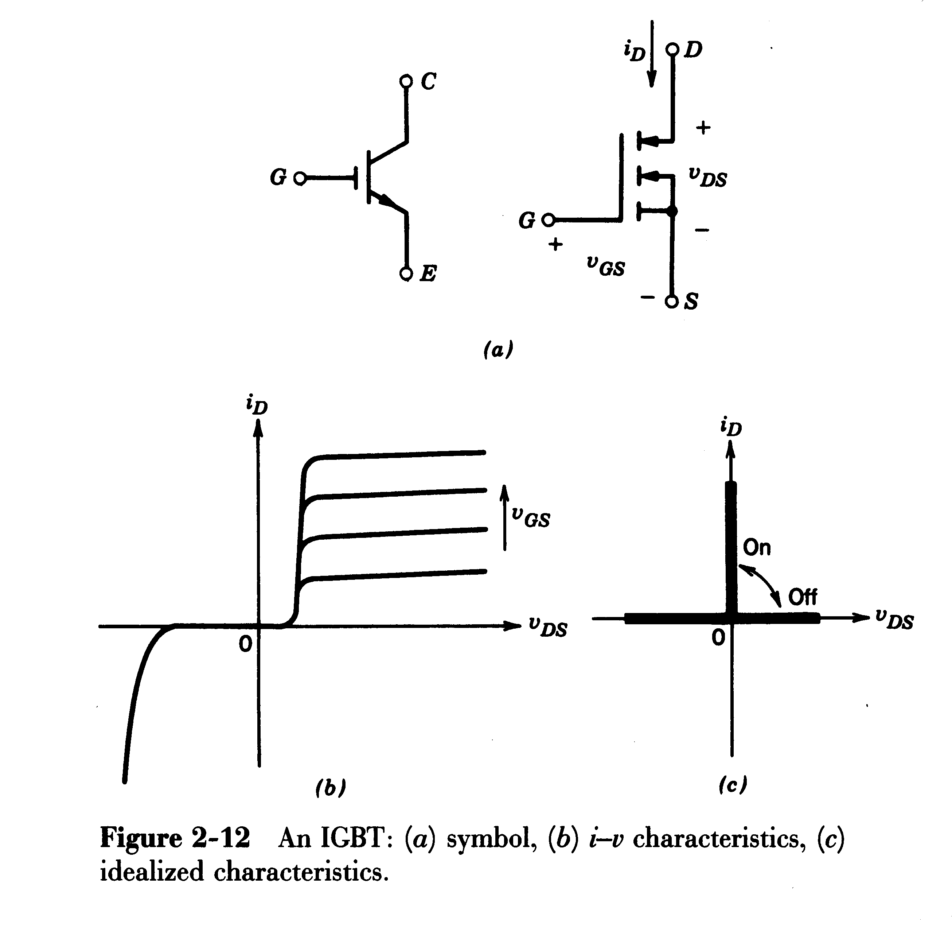
2-8 IGBT (Insulated Gate Bipolar Transistor)
i_{c}
i_{c}
v_{ce}
v_{ce}

Slide 65
2 Features and applications of IGBT ☆
Composite device（复合器件）.
Voltage-driven device, easy to control by the gate, high impedance gate which requires only a small amount of energy to switch the device (Similar to MOSFET).
On-state resistance has a positive temperature coefficient (On-state resistance goes up with the junction temperature within the device ) , therefore easily paralleled. (Similar to MOSFET).
Fast switching speed, used in high operating frequency applications (typical switching frequencies: 3-30kHz).
low On-state resistance (voltage), even in large blocking voltage rating, used in a vast voltage and power range (from a fractional kW to several MWs ).

Slide 66
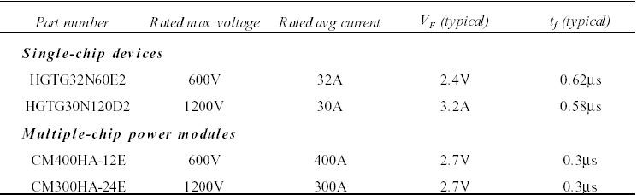
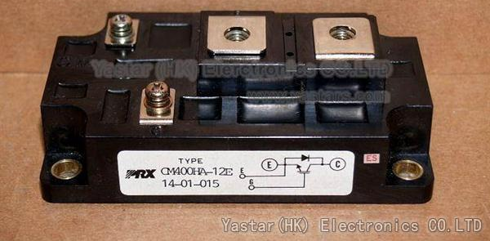
Examples of commercial IGBT

Slide 67
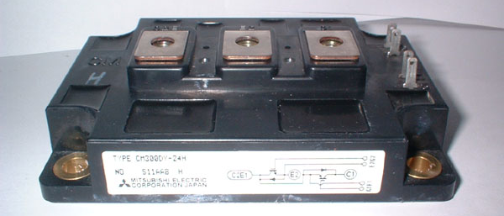
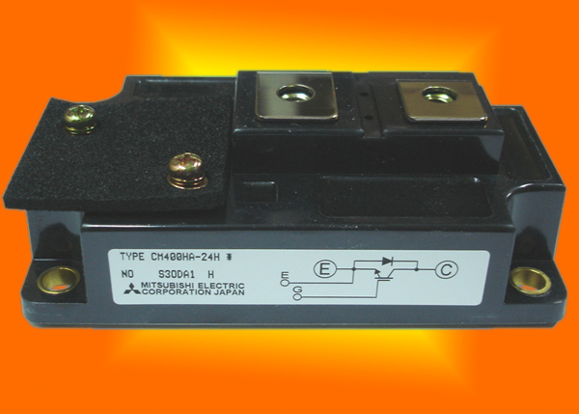

Slide 68
2-10 Comparison of Controllable Switches
In design a power electronic converter, it is extremely important to consider the available power semiconductor devices and their characteristics. The choice of devices depends on the applications. Some of the device properties are listed here:
1. On-state voltage or on-state resistance dictates the conduction losses in the device.
2. Switching times dictate the energy loss per transition and determine how high the operating frequency can be.
3. Voltage and current ratings determine the device power-handling capability.

Slide 69

4. The power required by the control circuit determines the ease of controlling the device.
5. The temperature coefficient of the device on-state resistance determines the ease of connecting them in parallel to handle large currents.
6. Device cost is a factor in its selection.

Slide 70

Summary of Device Capabilities ☆
Available rated voltage ratings and current ratings
Available switch frequency

Slide 71
Supplemental Material
电力二极管（D）——Power Diode
快恢复二极管（FRD）——Fast Recovery Diode
晶闸管/可控硅（SCR）——Thyristor （Silcon Controlled Rectifier）
快速晶闸管（FST）——Fast Switching Thyristor
光控晶闸管（LTT）——Light Triggered Thyristor
双向晶闸管（TRIAC）——Bidirectional triode Thyristor
逆导晶闸管（RCT）——Reverse Conducting Thyristor
门极可关断晶闸管(GTO)——Gate Turn Off Thyristor

Slide 72
Supplemental Material
集成门极换流晶闸管(IGCT)——Integrated Gate-Commutated Thyristor
电力晶体管（GTR）或双极结型晶体管(BJT)——Giant Transistor或Bipolar Junction Transistor
电力场效应晶体管(电力 MOSFET)——Electric field effect transistor
绝缘栅双极晶体管(IGBT)——Insulated-gate Bipolar Transistor
MOS控制晶闸管（MCT）——MOS controlled Thyristor
静电感应晶闸管(SITH)—Static Induction Thyristor
静电感应晶体管(SIT)—Static Induction Transistor

Slide 73
Review Questions
1. What are power electronics?
2. What is the gating characteristic of an IGBT?
3. What is the gating characteristic of a MOSFET?
4. What are the types of power diodes?
5. What is a reverse recovery time of diodes?
6. What is a reverse recovery current of diodes?
7. Why is it necessary to use fast-recovery diodes for high-speed switching?

Slide 74

Chapter 2
2-1 the data sheet of a switching device specify the following switching times corresponding to the linearized characteristics shown in Fig. 2-6b for clamped-inductive switchings: t_{ri}=100 ns, t_{fv}=50 ns, t_{rv}=100 ns, t_{fi}=200 ns.
Calculate and plot the switching power loss as a function of frequency in a range of 25~100 kHz, assuming V_{d}=300 V and I_{o}=4A in the circuit of Fig. 2-6a.

Slide 75
Chapter 2
2-2 Consider the resistive-switching circuit shown in fig. P2-2. V_{d}=300V, f_{s}=100kHz and R=75Ω, so that the on-state current is the same as in Problem 2-1. Assume the switch turn-on time to be the sum of t_{ri} and t_{fv} in problem 2-1. similarly, assume the turn-off time to be the sum of t_{rv} and t_{fi}. Assume linear voltage- and current-switching characteristics, plot the switch voltage and current and the switching power loss as a function of time. Compare the average power loss with that in Problem 2-1.
+
V_{d}
-
i_{T}
R
+
V_{T}
-
Fig. P2-2

Slide 76


Chapter 2
S2-1 Draw the ideal characteristics for (I) A diode (II) A thyristor
S2-2 The figure below shows a simple rectifier. Assume the diode to be ideal. Given:
(I) Sketch the voltage v_{d}(t) over the load resistance R, as a function of time. This is the voltage from the rectifier.
(II) Sketch the voltage over the diode D, as a function of time.
(III) Calculate the average value V_{d} of the output voltage v_{d}(t).

